Slide 1


ANALYSIs
MENU
ANALYSIS
CONTACT
Data ANALYSIS
Data Analyst Intern
Fatma
Corona virus
SQL and data analysis skills in real-world context

Slide 2
CONTENTS
MENU
ANALYSIS
CONTACT
Data ANALYSIS
Introduction.
Dataset Overview.
Data Exploration and analysis.
Key Findings.
Conclusion.

Slide 3

INTRODUCTION
MENU
ANALYSIS
CONTACT
Data ANALYSIS
The CORONA VIRUS pandemic has had a significant impact on public health and has created an urgent need for data-driven insights to understand the spread of the virus.
As a data analyst, I analysed the CORONA VIRUS dataset to derive meaningful insights and present my findings.

Slide 4



Dataset Overview
Province
Country/Region
Latitude
MENU
ANALYSIS
CONTACT
Data ANALYSIS
Geographic subdivision within a country/region.
Geographic entity where data is recorded
North-south position on Earth's surface.
Notes:
Description of each column in our dataset, our the dataset is composed of one and only one table with different columns and we will state the description of each column separately I order to have a better understanding of what we are dealing with.

Slide 5



Dataset Overview
Longitude
Date
Confirmed
MENU
ANALYSIS
CONTACT
Data ANALYSIS
East-west position on Earth's surface.
Recorded date of CORONA VIRUS data.
Number of diagnosed CORONA VIRUS cases

Slide 6


Dataset Overview
Deaths
Recovered
MENU
ANALYSIS
CONTACT
Data ANALYSIS
Number of CORONA VIRUS related deaths.
Number of recovered CORONA VIRUS cases.

Slide 7

Data Exploration and analysis
MENU
ANALYSIS
CONTACT
Data ANALYSIS
Setting up our Database.
Data Cleaning.
Analyse Data to Answer Questions.

Slide 8
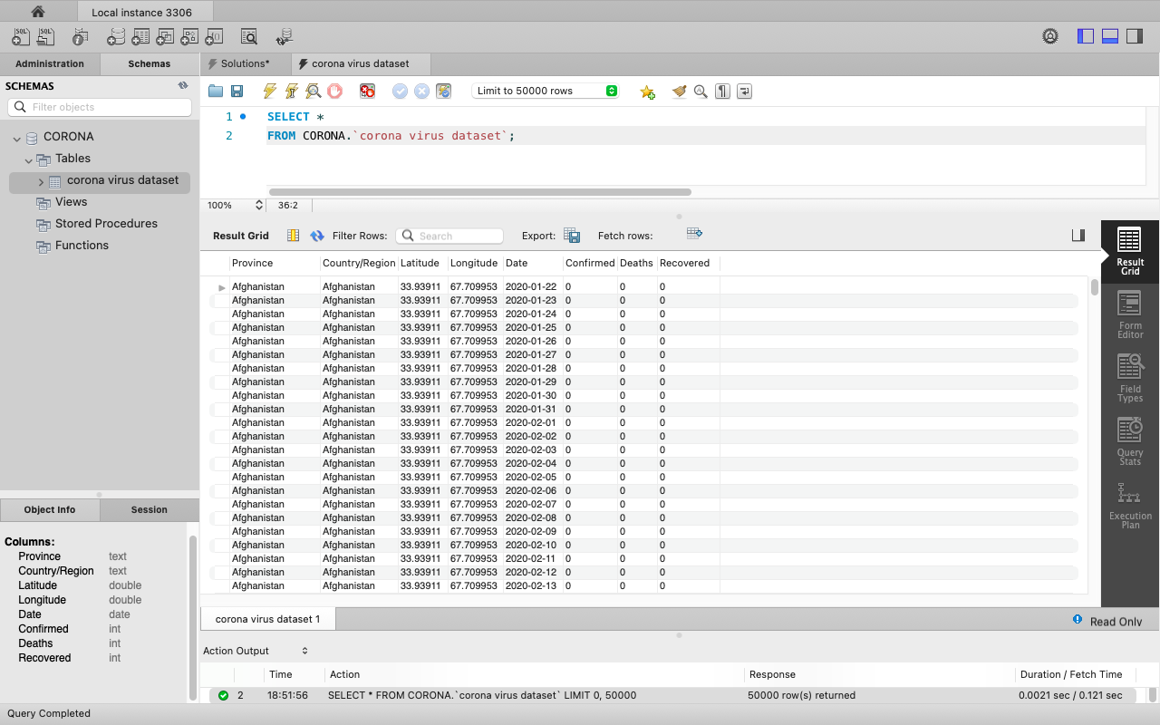
Data Exploration and analysis
MENU
ANALYSIS
CONTACT
Data ANALYSIS
Setting up our Database

Slide 9
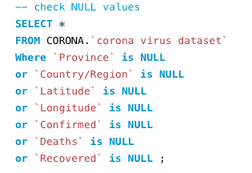
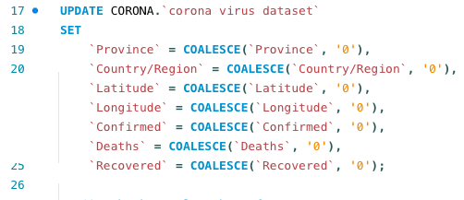
Data Exploration and analysis-Data Cleaning
MENU
ANALYSIS
CONTACT
Data ANALYSIS
Checking for NULL Values
Updating NULL Values

Slide 10
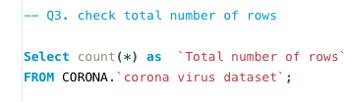
386
MENU
ANALYSIS
CONTACT
Data ANALYSIS
78,
Total Number of Rows in our Dataset

Slide 11

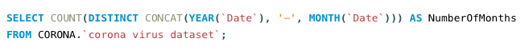
Start_DATE And End_Date
MENU
ANALYSIS
CONTACT
Data ANALYSIS
From
To
2020-01-22
2021-06-13
Number of months present in our dataset : 18

Slide 12
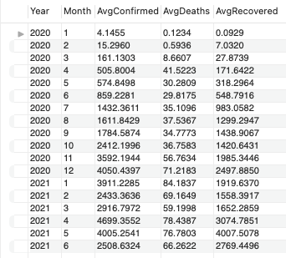
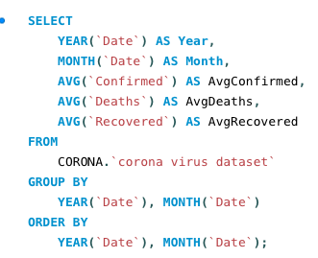
Data ANalysis
Data ANALYSIS
MENU
ANALYSIS
CONTACT
Monthly averages for confirmed, deaths, recovered

Slide 13
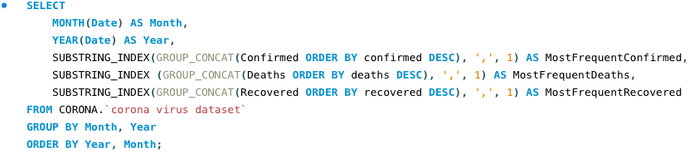
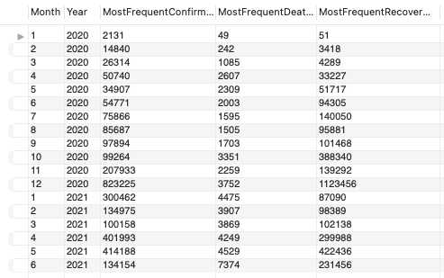
Data ANalysis
Data ANALYSIS
MENU
ANALYSIS
CONTACT
Most frequent values monthly

Slide 14
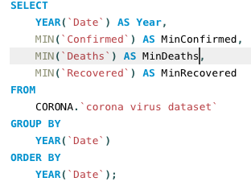

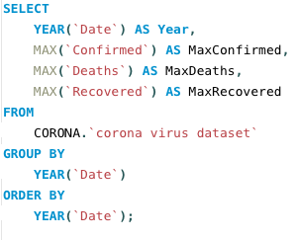

Data ANalysis
Data ANALYSIS
MENU
ANALYSIS
CONTACT
Min & Maxi values per year

Slide 15
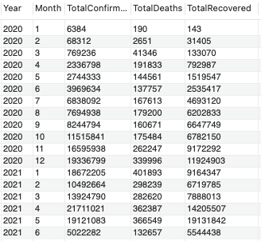
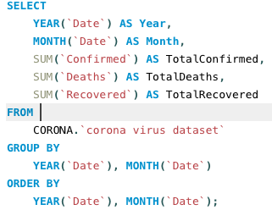
Data analysis
MENU
ANALYSIS
CONTACT
Data ANALYSIS
Total number of cases of confirmed, deaths, recovered each month

Slide 16
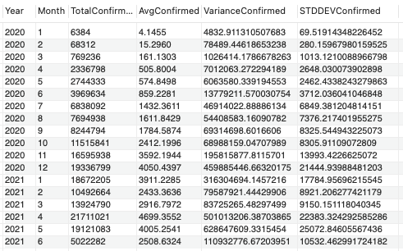
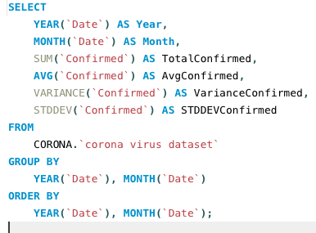
Data analysis
MENU
ANALYSIS
CONTACT
Data ANALYSIS
Corona virus spread out with respect to confirmed cases

Slide 17
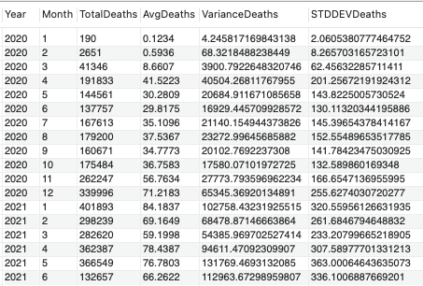
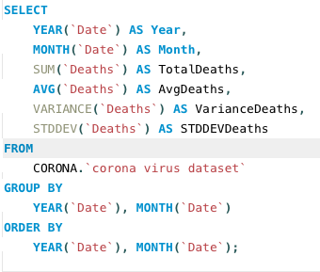
Data analysis
MENU
ANALYSIS
CONTACT
Data ANALYSIS
Corona virus spread out with respect to death cases

Slide 18
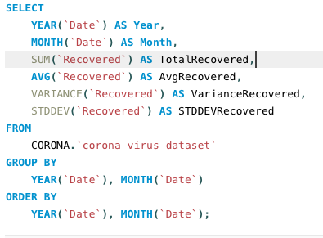
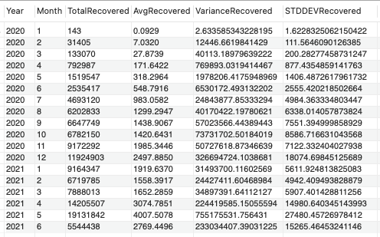
Data analysis
MENU
ANALYSIS
CONTACT
Data ANALYSIS
Corona virus spread out with respect to recovered cases

Slide 19
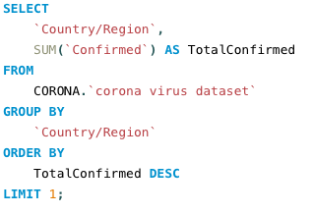
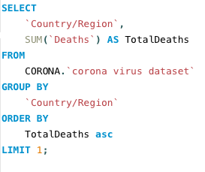


Data analysis
MENU
ANALYSIS
CONTACT
Data ANALYSIS
Country having highest number of the Confirmed case
Country having lowest number of the death case

Slide 20
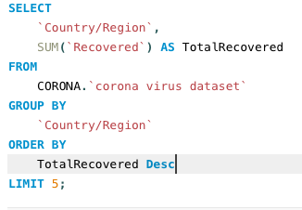
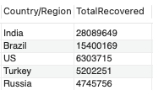
DATA analysis
MENU
ANALYSIS
CONTACT
Data ANALYSIS
Top 5 countries having highest recovered case

Slide 21
Key findings
MENU
ANALYSIS
CONTACT
Data ANALYSIS
Temporal Analysis
Monthly Trends
Geographical Analysis
Focus Areas for Intervention
Statistical Insights
Notes:
Temporal Analysis
Understanding the time frame covered by the dataset and the distribution of data over months facilitates temporal trend analysis.
Geographical Analysis
Identification of countries with the highest confirmed cases, lowest death cases, and highest recovered cases offer insights into the geographical impact and effectiveness of response efforts.
Statistical Insights
Calculation of averages, minimums, maximums, and spread measures like variance and standard deviation provide statistical insights into the COVID-19 data.
Monthly Trends
Analysis of monthly averages, most frequent values, and total cases per month reveal patterns and fluctuations in COVID-19 metrics over time.
Focus Areas for Intervention
Identification of areas with high confirmed cases or low recovery rates can guide resource allocation and intervention strategies.

Slide 22
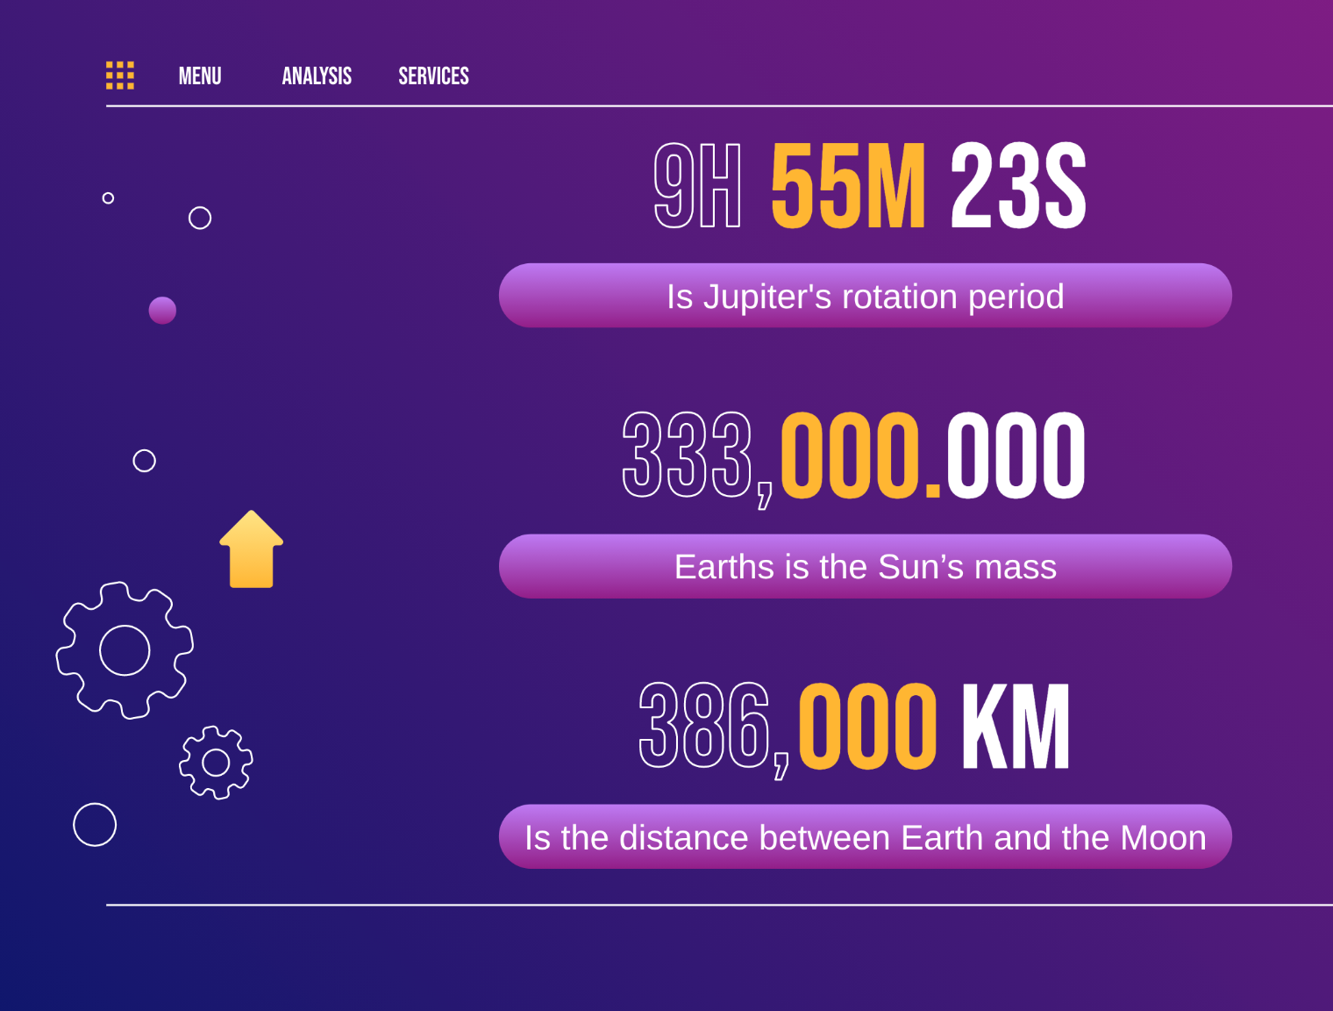
Conclusion
MENU
ANALYSIS
CONTACT
Data ANALYSIS
THANKS!
Notes:
In conclusion, the analysis of the provided COVID-19 dataset offered valuable insights into the pandemic's progression, impact, and response efforts. By ensuring data integrity, identifying temporal trends, and providing statistical measures, we've gained a deeper understanding of the virus's spread and its effects globally.

